Slide 1
COVID-19 CLINICAL TRIAL EXPLORATORY DATA ANAYSIS
RAMPRASAD M

Slide 2
Project analysis slide 2
OBJECTIVE
To analyze global COVID-19 clinical trial data and identify patterns in trial status, phases, funding, geography, enrollment, and trends.
MATPLOTLIB
PANDAS
TOOLS
SEABORN
PYTHON
NUMPY
GOOGLE COLAB

Slide 3
Project analysis slide 6
Key Analysis
Trial Phases
Enrolment Distribution
Trial Status
Geographic Distribution
Funding Patterns
Research Trend

Slide 4
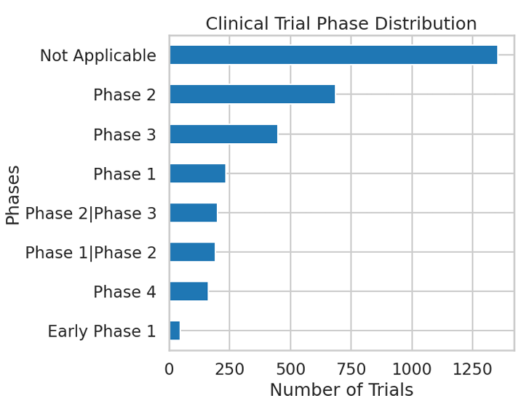
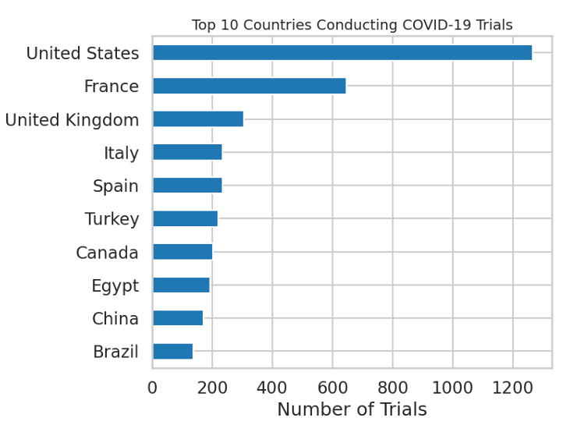
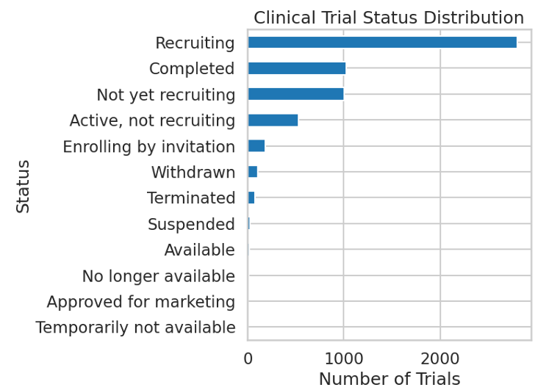
KEY INSIGHTS
Trial Activity: A large number of trials were found to be either recruiting or completed, indicating sustained global research efforts.
Trial Phases: Most studies progressed to Phase 2 and Phase 3, suggesting rapid advancement beyond early-stage testing.
Geographic Distribution: Countries with strong research infrastructure conducted the highest number of trials, highlighting global disparities.

Slide 5
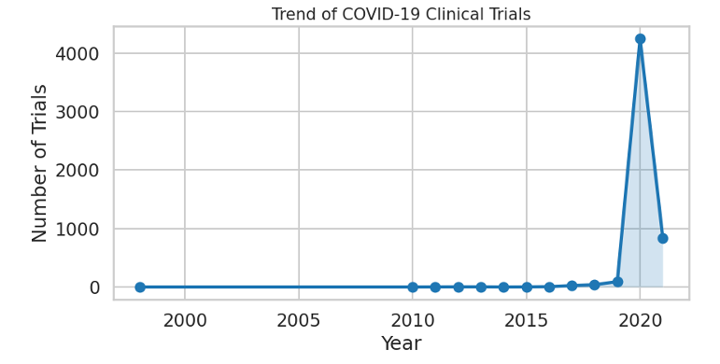
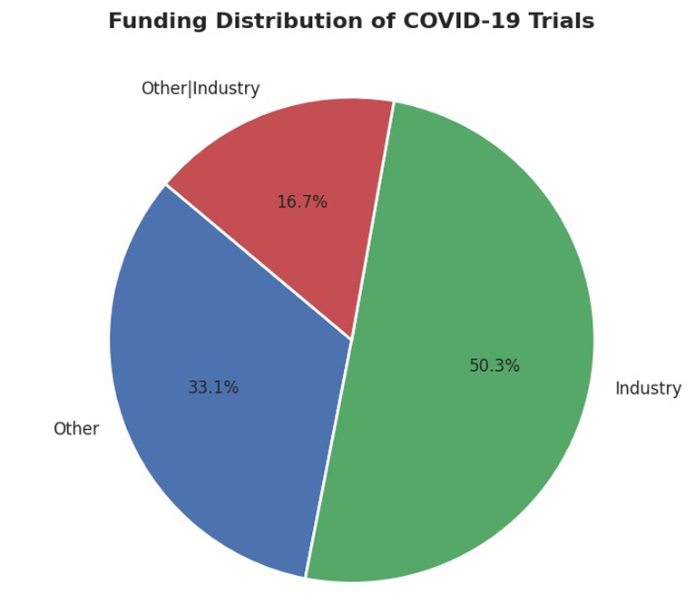
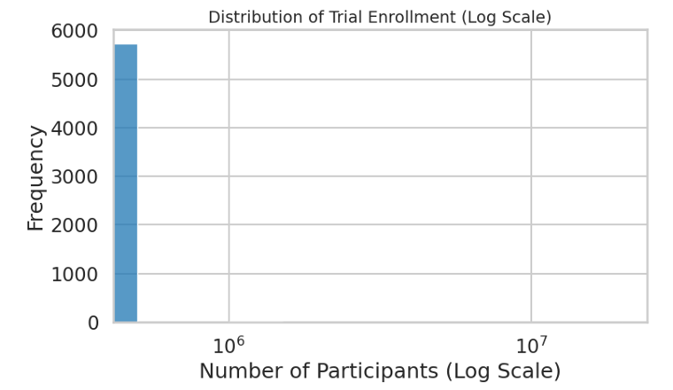
KEY INSIGHTS
4. Funding Pattern: Government and industry funding were the primary contributors,
emphasizing the importance of public-private collaboration.
5. Enrollment Variation: Participant numbers varied widely, reflecting both small
experimental studies and large-scale clinical investigations.
6.Research Timeline: Clinical trial activity surged during peak pandemic years, demonstrating an urgent worldwide scientific response.

Slide 6

Project analysis slide 7
CONCLUSION
This analysis highlights the scale and speed of the global scientific response to COVID-19. The findings emphasize the importance of collaboration, funding, and research infrastructure in addressing public health emergencies.

Slide 7
Thank You

